Slide 1
Data For Good
JP Morgan
SPORTS DANS LA VILLE
TEAM 8

Slide 2
Problem Statement
How can Sports dans la Ville maximize its donations and revenue streams to better accomplish its mission?

Slide 3
Outline and Framework Key criteria used to prioritize the most attractive sectors and identify opportunities that could maximise donations.
The 5 steps of the analysis
1
2
3
4
5
Problem Statement & approach
Data Analysis
Marketing Opportunities
Leveraging domain knowledge
Revenue Forecasting
Opportunities
Business Accounts
Contacts
Invoices
Key Data Sets Analyzed
External Data: France Generosite

Slide 4
Where is the money?
Analysis of past opportunities

Slide 5
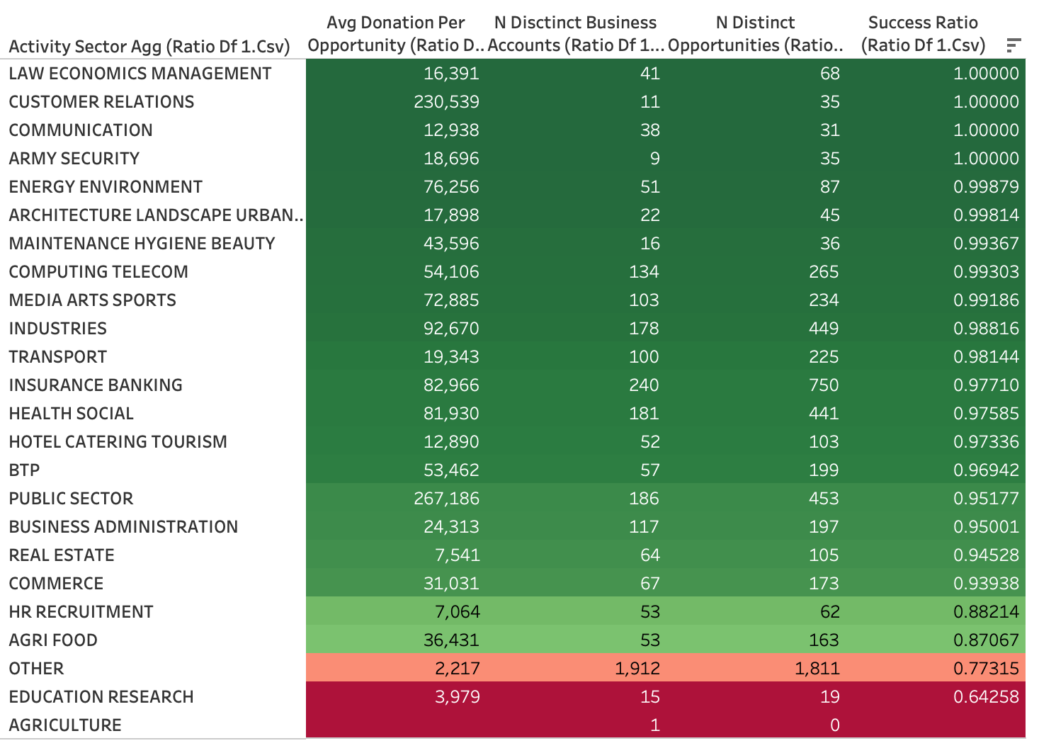
We defined a Success Ratio for won and lost opportunities
Success Ratio = Actual Amount Received / Expected Amount
Most sectors perform better than the others with a success ration of close to 1.0
We want to focus on sectors which have a high success ratio.

Slide 6
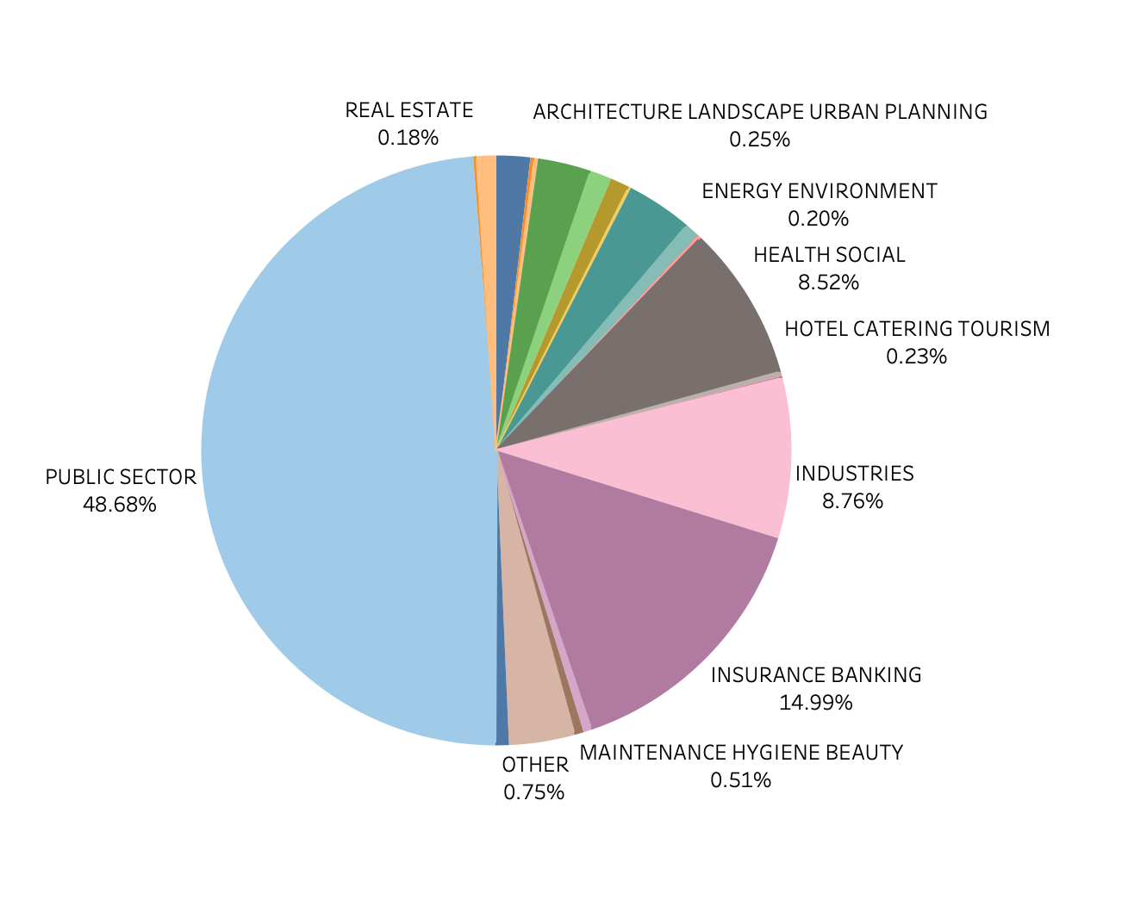
Activity Sector Analysis Looking at the contribution of each sector towards amount received for won opportunities
Public sector’s contribution is the highest and it has a high success ratio as well.
Law Economics and Management has comparatively much lower amount received but it has a very high success ratio.
Customer Relations has a high average donation along with a high success rate.

Slide 7
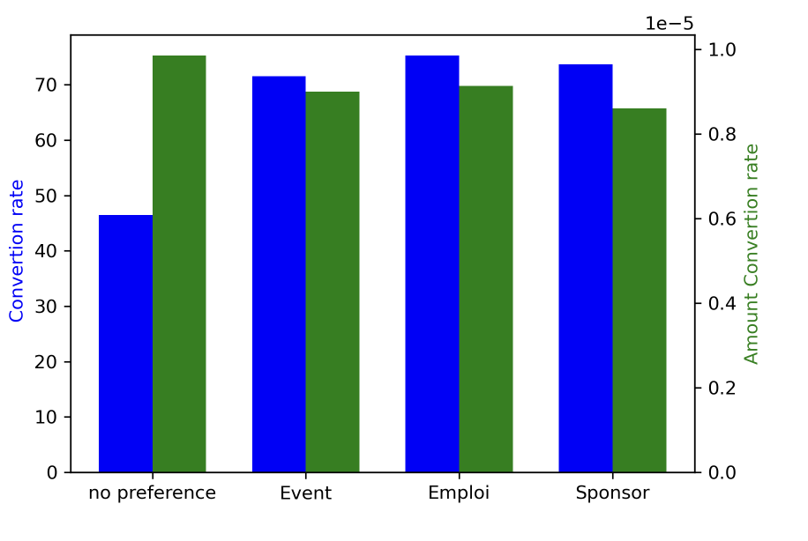
Type of Financial channels analysis Looking at the contribution of each channel towards amount received for won opportunities
Employment
PRIORITY 1
Sponsorship & Events
PRIORITY 2

Slide 8
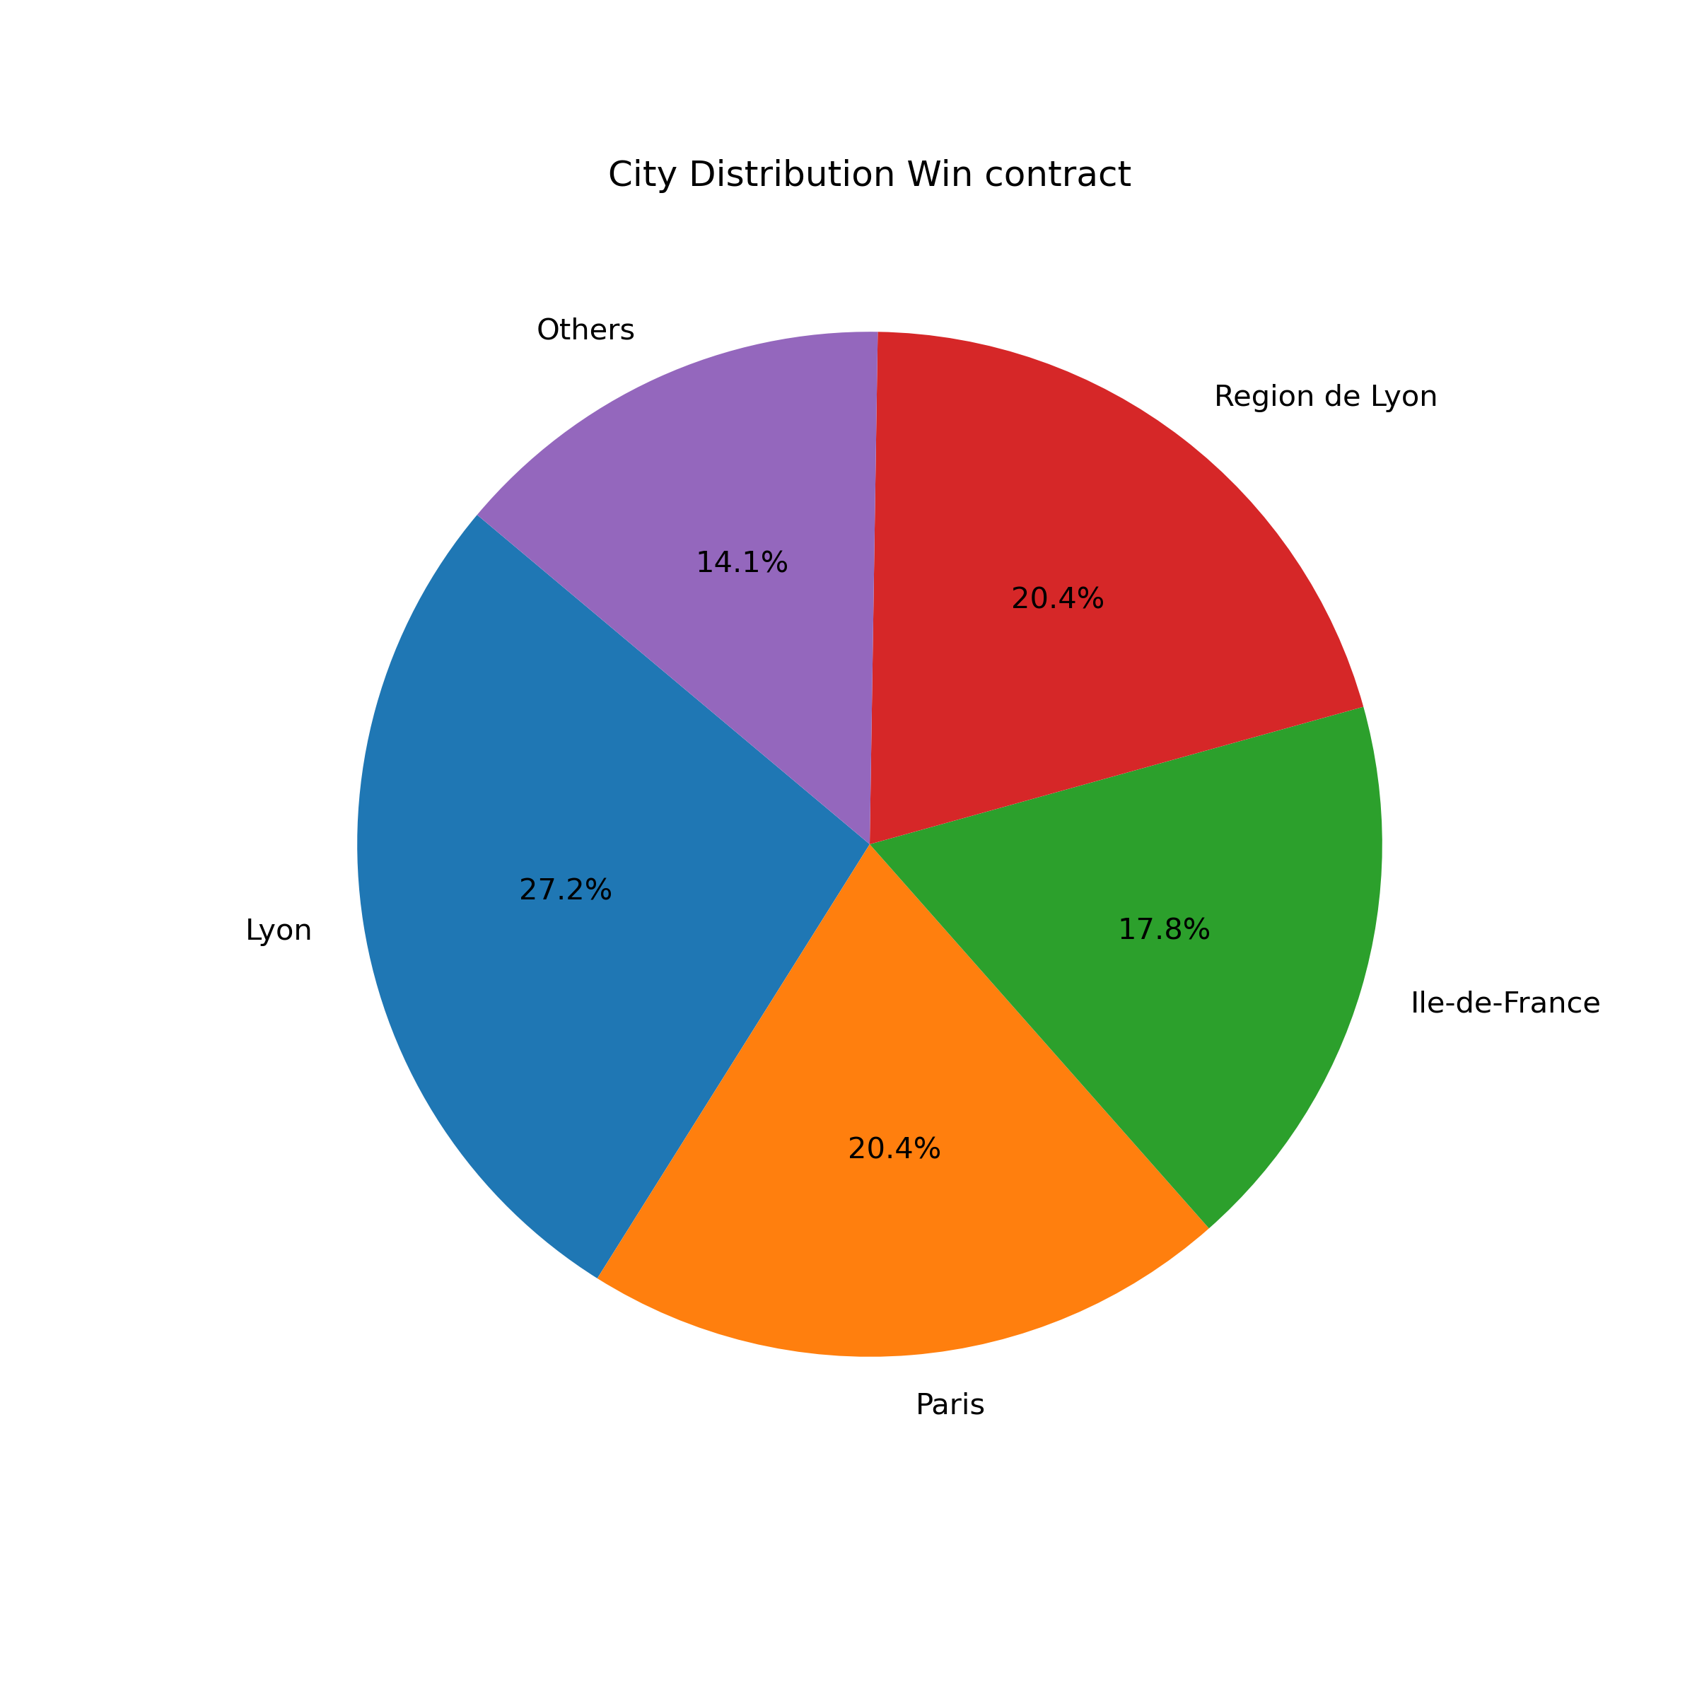
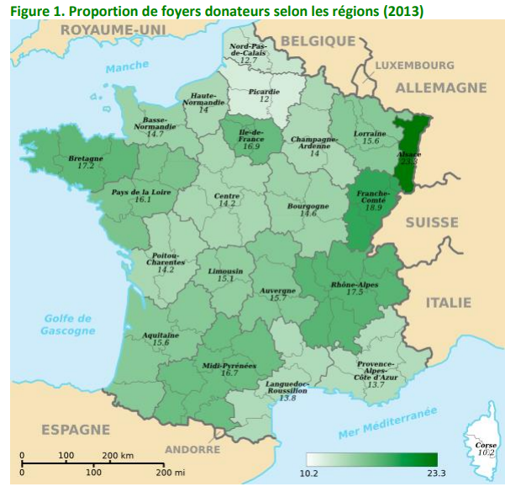
Donors Location Analysis Looking at the contribution of French regions to the amount received for won opportunities

Slide 9
Let’s make (easy) money!
Identifying unexploited sources of revenues

Slide 10
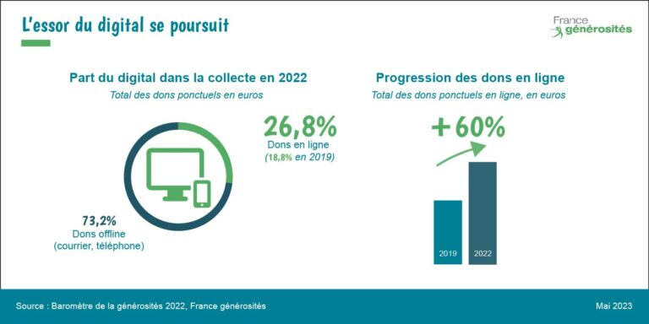
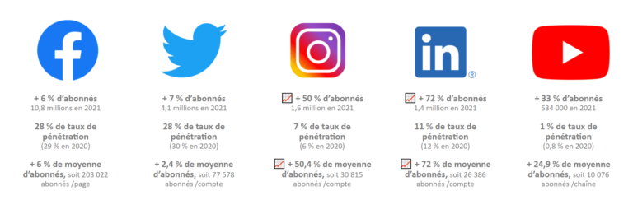
What about Digital Donation? Looking at the contribution of digital donations to the revenues
Only 8.2% of the donors donate online.
Only 0.03% of the total donations received by Sports dans la Ville come from online donations.
→ This is far below the national average!!!

Slide 11
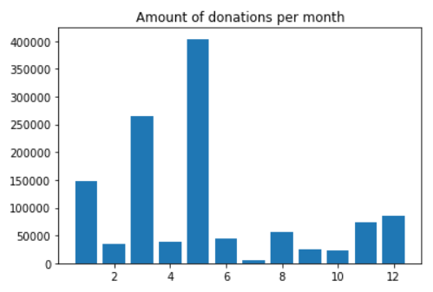
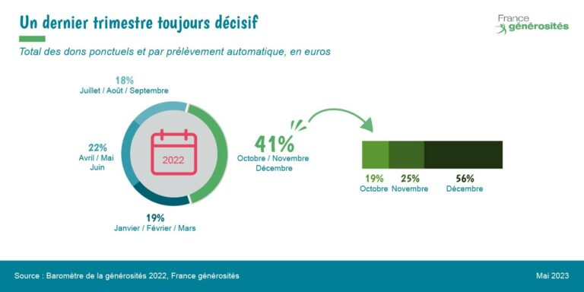
When to prospect individual people? Identifying the most favourable months of the year for donations

Slide 12
When will Sports dans la Ville get the money?
Predicting future revenues for optimized investments

Slide 13
2 main issues remaining !
When will they get the money ?
Very difficult to provide accurate estimates…
Having some insights on these issues would allow Sports dans la Ville to be more secure regarding their inventory and make safer investments.
What real amount will be received in the end ?

Slide 14
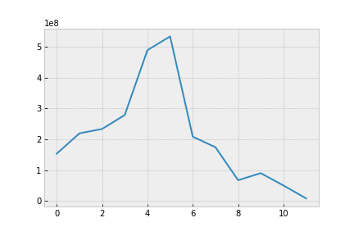
Our proposal :
A user-friendly tool to predict these revenues thanks to two sources of information : - Estimated time to full payment (linear regression) - Estimated paid amount using “success ratios” computed per opportunity class

Slide 15
Q & A

